Slide 1
Multidimensional Access Methods
NGUYỄN LÊ HOÀNG
TRẦN NGỌC NHƯ QUỲNH

Slide 2
PREFACE
Data Management:
Geosciences
Mechanical CAD
Robotics
Autonomous Navigation
Environmental Protection
Medical Imaging
➔ SPATIAL DATABASE SYSTEM
➔ Challenges: find Abstractions and Architectures to implement Systems.
Notes:
VLSI: Very Large Scale Integration: the process of creating an integrated circuit by combining thousands of transistors into a single chip.
CAD: Computer Aided Design: the use of computer systems to assist the creation, modification, analysis, or optimization of a design.

Slide 3
CONTENTS
1. SPATIAL DATA
2. BASIC DATA STRUCTURES
3. POINT ACCESS METHODS
4. SPATIAL ACCESS METHODS
5.CONCLUSIONS

Slide 4
1. SPATIAL DATA
Basic Properties
Requirements for MAMs
PAMs and SAMs
Common Queries

Slide 5
1. SPATIAL DATA BASIC PROPERTIES
1. Complex Structures
2. Dynamic Data
3. Large Databases
4. No Standard Algebra
5. Complicated and Costly Operators
Notes:
Để có được sự hiểu biết tốt hơn về các yêu cầu trong các hệ thống cơ sở dữ liệu không gian, đầu tiên chúng ta cần thảo luận về một số đặc tính cơ bản của dữ liệu không gian.
Complex Structures (Cấu trúc phức tạp)
dữ liệu không gian có một cấu trúc phức tạp
Một đối tượng dữ liệu không gian có thể được tạo thành từ một điểm duy nhất hoặc một số hàng ngàn đa giác, phân bố tùy ý trong không gian.
2. Dynamic Data (Dữ liệu động)
Việc thêm mới và xóa bỏ thường được xen kẽ với việc cập nhật,
và các cấu trúc dữ liệu được sử dụng trong bối cảnh này phải hỗ trợ các hành vi động mà không bị chuyển biến xấu đi theo thời gian.
3. Large Databases
- Dữ liệu không gian thường có xu hướng lớn dần.
- Bản đồ địa lý là 1 ví dụ; thường chiếm dung lượng lưu trữ lên tới vài Gigabytes. Việc tích hợp bộ nhớ thứ cấp với bộ nhớ chính là cần thiết để xử lý dữ liệu hiệu quả.
4. No standard set of operators
không có đại số (con số) tiêu chuẩn nào được xác định trên dữ liệu không gian.
5. Operators return any kind of objects

Slide 6
1. SPATIAL DATA REQUIREMENTS
1. Dynamics
2. Secondary Storage Management
3. Broad range of supported operations
4. Independence of the input data and insertion sequence
5. Simplicity
6. Scalability
7. Time efficiency
8. Space efficiency
9. Concurrency and Recovery
Notes:
Sau đây, là một loạt các yêu cầu tiêu biểu mà các “Phương pháp tiếp cận đa chiều” nên đáp ứng, dựa trên các thuộc tính của Dữ liệu không gian và ứng dụng trong thực tế mà người khai triển đang thực hiện:
1. Keep tracks of changes: insertion or deletion: Khi đối tượng dữ liệu được chèn vào và xóa khỏi cơ sở dữ liệu theo thứ tự nhất định, các phương pháp tiếp cận nên liên tục theo dõi các thay đổi.
2. For big data: Dữ liệu không hoàn toàn được lưu trong Bộ nhớ chính; vì vậy, các p/pháp truy cập cần phải được tích hợp liền mạch giữa Bộ nhớ chính và bộ nhớ thứ.
3. Broad range of supported operations
4. Independence of the input data and insertion sequence.
Sự độc lập các dữ liệu đầu và, không theo thứ tự được insert.
5. Sự đơn giản: Các phương thức truy cập quá phức tạp, thường khó thực hiện/áp dụng, dễ bị lỗi; khó triển khai cho các ứng dụng ở quy mô lớn.
6. Khả năng mở rộng: Phương pháp truy cập nên thích nghi tốt với sự phát triển cơ sở dữ liệu.
7. Time efficiency: thời gian hiệu quả. Việc tìm kiếm Dữ liệu không gian phải nhanh.
8. Hiệu quả không gian: Chỉ mục nên có kích thước nhỏ so với các dữ liệu được giải quyết và do đó đảm bảo sử dụng lưu trữ nhất định.
9. Truy cập đồng thời và khả năng phục hồi: Trong cơ sở dữ liệu hiện đại mà nhiều người dùng đồng thời cập nhật; tải về, và chèn dữ liệu, phương pháp truy cập sẽ cung cấp các kỹ thuật mạnh mẽ để quản lý giao dịch

Slide 7
1. SPATIAL DATA PAMs and SAMs
Multidimensional Access Methods
Point Access Methods (PAMs): perform spatial search in Point database
Spatial Access Methods (SAMs): manage extended objects: lines, polygons, …
Reminders:
d-dimensional Euclidean space E(d)
A point: unique location with d coordinates
Hyperplane
Half space
Notes:
PAMs: Những điểm có thể được nhúng vào trong hai hoặc nhiều kích thước.
SAMs:

Slide 8
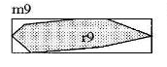
1. SPATIAL DATA
Object o: is defined by several non spatial attributes and one attribute of some spatial data type.
Object’s spatial extent o.G
Before inserting objects into an index:
Abstract complex objects with simpler shapes like bounding box or sphere.
Decomposition: represent a shape with union of simpler shapes.
Notes:
Đối tượng o: được xác định bởi một số thuộc tính không gian và một thuộc tính của một số loại dữ liệu không gian. O.G: miền Không gian lưu trữ của đối tượng o.

Slide 9

1. SPATIAL DATA QUERIES
No standard query language
Operators depend on application domain
QUERY 1: Exact Match Query EMQ, Object Query
Returns objects with the same spatial extent

Slide 10
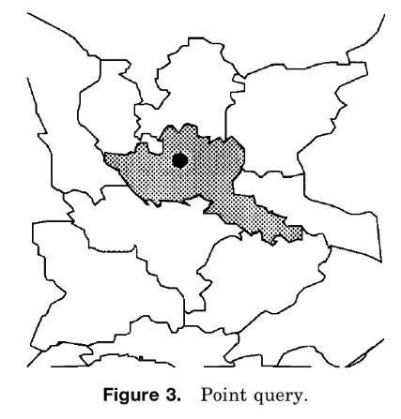

1. SPATIAL DATA QUERIES
QUERY 2: Point Query PQ
Returns objects that contain a given point

Slide 11
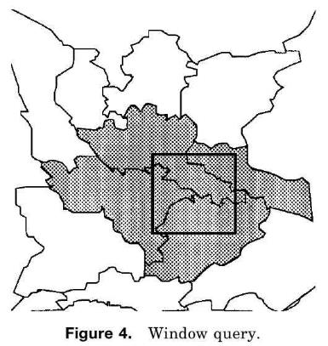

1. SPATIAL DATA QUERIES
QUERY 3: Window Query WQ, Range Query
Returns objects that contain at least one point
Returns isolated objects

Slide 12
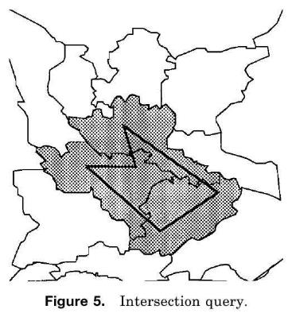

1. SPATIAL DATA QUERIES
QUERY 4: Intersection Query IQ, Region Query, Overlap Query
Returns objects that contain at least one common point with another object.

Slide 13
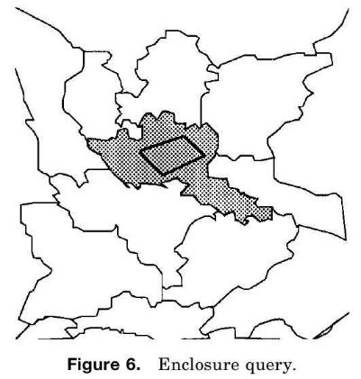
1. SPATIAL DATA QUERIES
QUERY 5: Enclosure Query EQ
Returns objects that enclose another object.

Slide 14
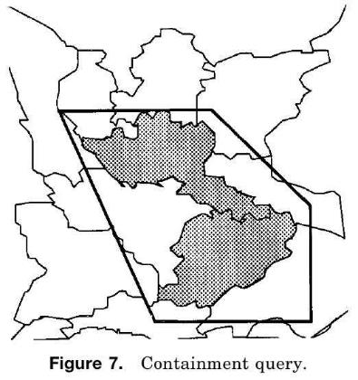

1. SPATIAL DATA QUERIES
QUERY 6: Containment Query CQ
Returns objects that are contained in another object.

Slide 15
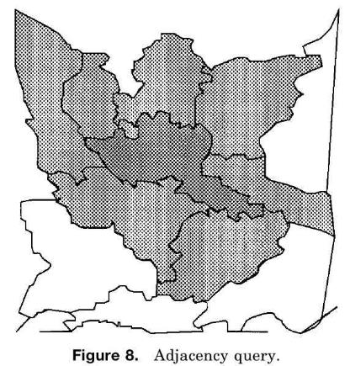

1. SPATIAL DATA QUERIES
QUERY 7: Adjacency Query AQ
Returns adjacent objects.
Notes:
Và một số các query khác nữa như:
- Nearest Neighbor Query NNQ
- Spatial Join

Slide 16
2. BASIC DATA STRUCTURES
ONE dimensional access methods:
Linear hashing
Extendible hashing
B-Tree
Main Memory Structures
K-d-Tree
Adaptive k-d-Tree
BSP Tree
BD Tree
Quadtree

Slide 17
2. BASIC DATA STRUCTURES
ONE DIMENSIONAL ACCESS METHODS
Linear Hashing:
Divide universe [A, B) of possible hash values into binary intervals with size: (B-A)/2^k and (B-A)/2^(k+1)
If a bucket is full, split the intervals to 2 equal subintervals
Put overload of a bucket in overflow page and link it to original
Extendible Hashing:
Binary intervals (cells)
Index in a directory for each cell
If a bucket is full, split all cells into two.
Pro: match takes at most 2 page accesses
Con: double growth

Slide 18
2. BASIC DATA STRUCTURES
ONE DIMENSIONAL ACCESS METHODS
B-Tree:
Organize data hierarchically
Balance
Relate to nesting of intervals
Interior node: point to immediate mutually disjoint descendants
Leaf node: data item
If a node is full, split it to two
Splits propagate up the tree
➔ Adaptive data structure

Slide 19
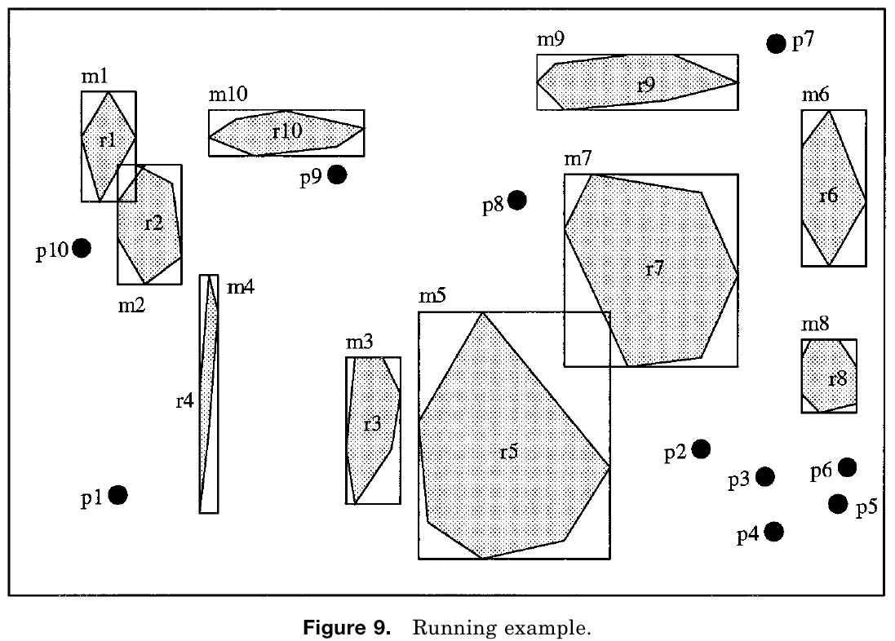
RUNNING EXAMPLE
Notes:
10 points pi
10 polygon ri: centroid ci & minimum bounding box MBB mi

Slide 20
2. BASIC DATA STRUCTURES
MAIN MEMORY STRUCTURES
The k-d-Tree:
Binary tree that can only handle points
Divide universe using (d-1)-dimensional hyperplanes
Hyperplane: iso-oriented and having at least 1 data point
Interior node: has 1 or 2 descendant nodes, used to guide search
Insert and Search are straight forward
Delete: require reorganizing a sub-tree
Cons:
Data points are scattered
Notes:
- Tìm kiếm và chèn các điểm mới là việc đơn giản. Xóa có phần phức tạp hơn và có thể gây ra một tổ chức lại các cây con dưới điểm dữ liệu bị xóa.
- Một bất lợi của k-d-cây rằng cấu trúc nhạy cảm với thứ tự các điểm được chèn vào. Các điểm dữ liệu nằm rải rác trên tất cả các node của cây cây.

Slide 21
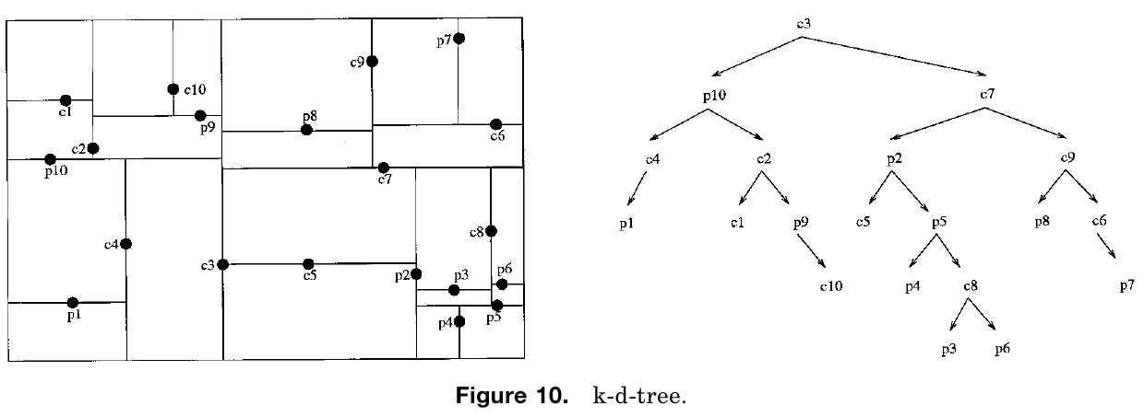
2. BASIC DATA STRUCTURES
MAIN MEMORY STRUCTURES
The k-d-Tree:

Slide 22
2. BASIC DATA STRUCTURES
MAIN MEMORY STRUCTURES
The Adaptive k-d-Tree:
Try to split with about the same number of elements in each side
Hyperplane: iso-oriented and need not contains data point
Split until each subspace has some specific number of elements
Interior nodes: contain dimension and coordinates of split
All data on leaves
Cons:
Unbalanced tree
For all k-d-tree: for some distributions, no hyper plane can split the data.
Notes:
- The adaptive k-d-tree đã giải quyết vấn đề này. Tất cả các điểm/miền đều nằm ở các node Lá của cây.
Các miền cắt vẫn còn nằm song song với trục
Khuyết điểm:
Khó khăn trong việc giữ cho cây được cân bằng nếu thực hiện các hoạt động chèn mới và xóa bỏ.
Ưu:
- Hoạt động tốt trên các môi trường tĩnh, ít cập nhật cây.

Slide 23
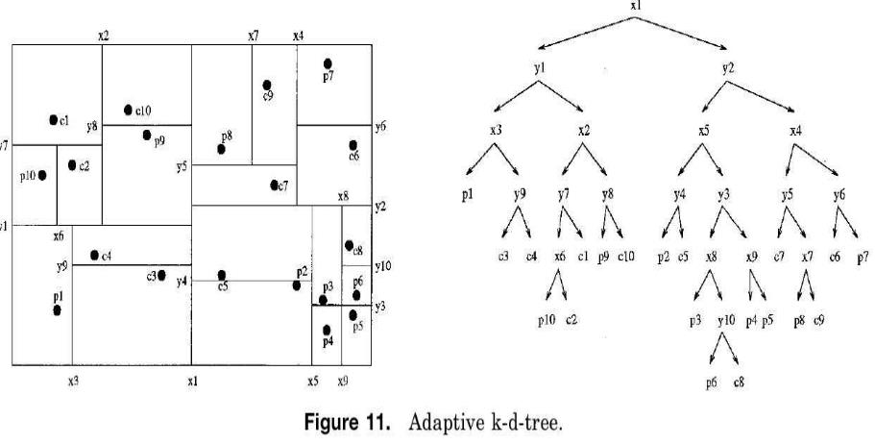
2. BASIC DATA STRUCTURES
MAIN MEMORY STRUCTURES
The Adaptive k-d-Tree:

Slide 24
2. BASIC DATA STRUCTURES
MAIN MEMORY STRUCTURES
The BSP Tree: (Binary Space Partitioning)
Split the universe
Hyperplane: arbitrary orientations (not iso-oriented), depends on the distribution of data
Decompose until number of objects is less than a threshold
Interior node: hyperplanes
Leaf nodes: subspaces, links to contained objects
Search: straight forward
Pros:
Adaptive for different distributions
Cons:
Not balanced
Notes:
Các kết quả phân vùng của vũ trụ:
mỗi hyperplane tương ứng với một nút bên trong của cây
và mỗi không gian con tương ứng với một lá.
Mỗi lá lưu trữ references cho các đối tượng được chứa trong các không gian con tương ứng.

Slide 25
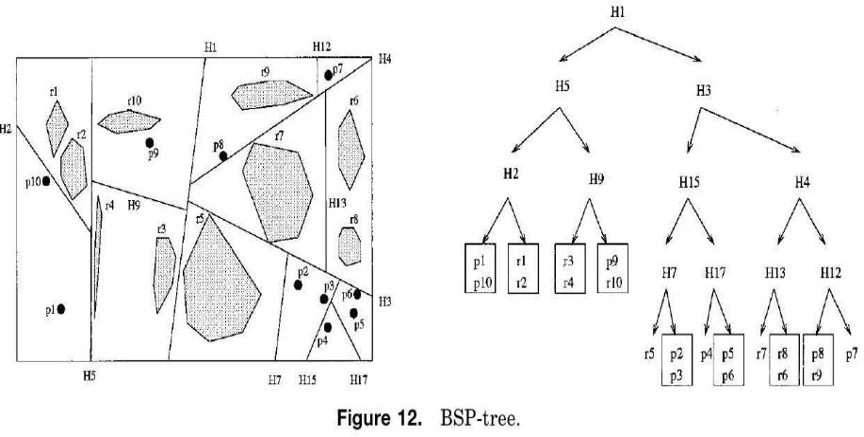
2. BASIC DATA STRUCTURES
MAIN MEMORY STRUCTURES
The BSP Tree: (Binary Space Partitioning)

Slide 26
2. BASIC DATA STRUCTURES
MAIN MEMORY STRUCTURES
The BD Tree:
Binary tree representing subdivisions of data into interval shaped regions
Encode regions in bit strings (DZ expressions, z values, …)
Bit values:
Left and down of hyperplanes : 0
Right and up of hyperplanes: 1
Interval-shaped excision: one node is excision (interval-shaped) part, the other one is remainder of the subspace
Searching: find full bit prefix of search record, then traverses the tree based on prefix

Slide 27
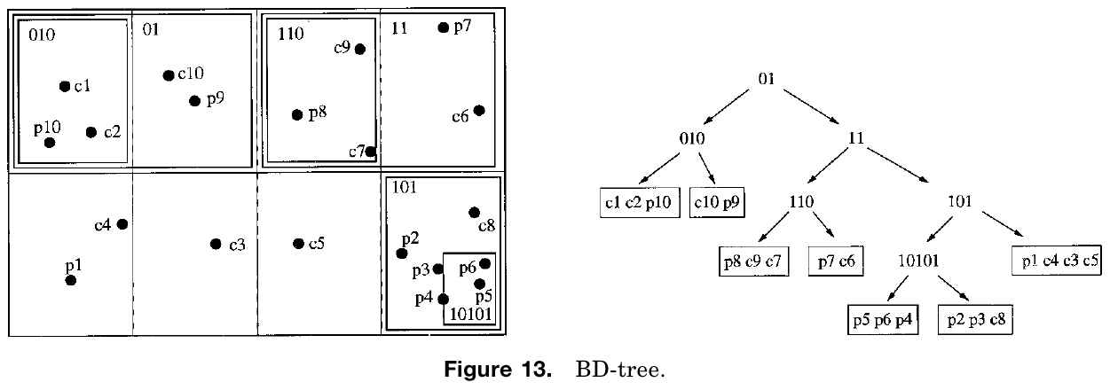
2. BASIC DATA STRUCTURES
MAIN MEMORY STRUCTURES
The BD Tree:

Slide 28
2. BASIC DATA STRUCTURES
MAIN MEMORY STRUCTURES
The Quadtree:
Closely similar to k-d-tree: decompose universe with iso-oriented hyperplanes
Not binary tree: each node has 2^d descendants (in d dimensional space)
Decompose until number of objects is less than a threshold
Each node: interval shaped partitions
Search is similar to k-d-tree
Point query: traverses one subtree
Region query: goes to often more than one subtree
Cons:
Not balanced

Slide 29
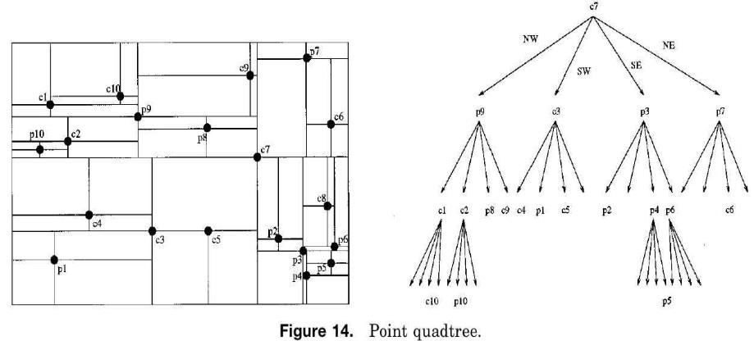
2. BASIC DATA STRUCTURES
MAIN MEMORY STRUCTURES
The Quadtree - Point Quadtree:
Divide corresponding partition to 2^d subspaces, new point in center
Notes:
constructed by inserting points one by one
deletion: requires reconstructing subtree

Slide 30
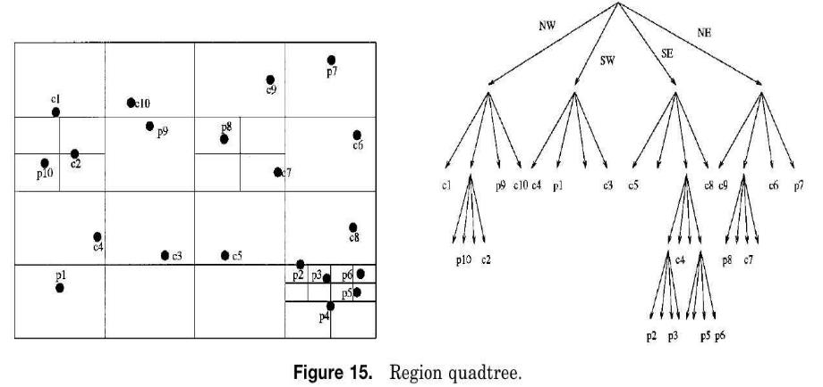
2. BASIC DATA STRUCTURES
MAIN MEMORY STRUCTURES
The Quadtree – Region Quadtree:
Regular decomposition of the universe to 2^d equal subspaces

Slide 31
3. POINT ACCESS METHODS
Multidimensional Hashing:
Grid File
EXCELL
Two-level Grid File
Twin Grid File
Hierarchical Access Methods:
K-d-B-Tree
LSD Tree
Buddy Tree
BANG File
Space-Filling Curves for Point Data
Notes:
Previous access methods: designed for main memory; not optimized for secondary storage (no control over how OS accesses disks)

Slide 32
RUNNING EXAMPLE
Notes:
10 points pi
10 polygon ri: centroid ci & minimum bounding box MBB mi

Slide 33
3. PAMs – Multidimensional Hashing
THE GRID FILE
Grid File:
Superimposes d-dimensional orthogonal grid on the universe
Grids not regular, different shapes and sizes for cells
Grid directory links cells to data buckets and is stored on disk per each
Search:
For exact match point query: use scales to locate cell
For range query: test all cells that overlap the search
Insert data: if bucket is full, requires cell splitting
Notes:
Deletion: possible to merge cells in some cases, find neighbor to merge > new problem

Slide 34
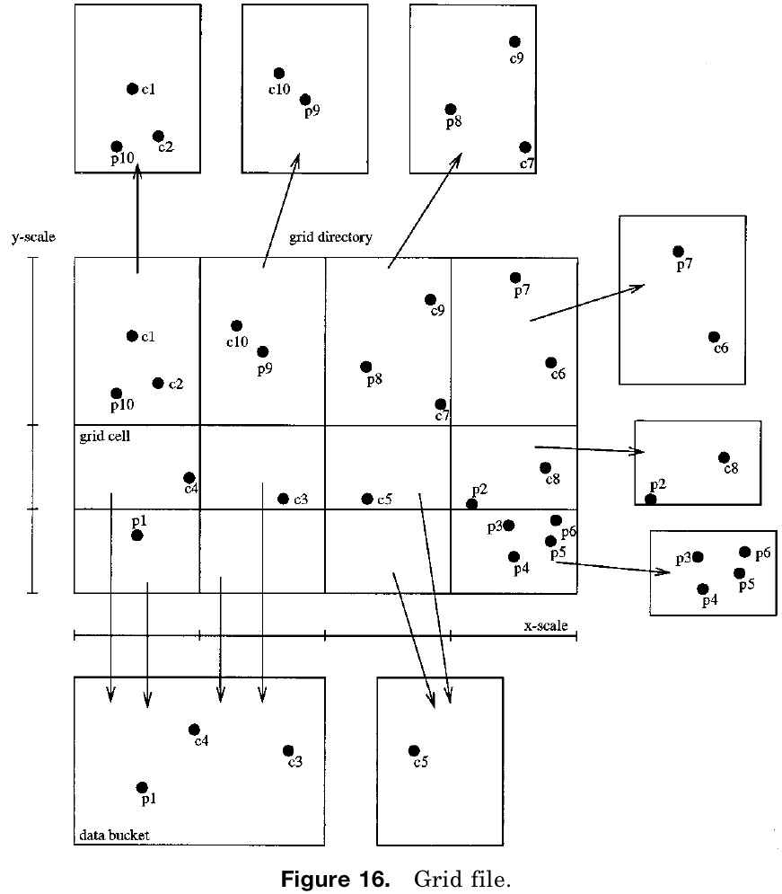
3. PAMs – Multidimensional Hashing
THE GRID FILE
Grid File:
Notes:
Capacity: 4points/ bucket
Data point displayed in the directory for demonstration only, not actually stored there.
4 directory for the same page: bot left

Slide 35
3. PAMs – Multidimensional Hashing
EXCELL
EXCELL (Extendible Cell)
Like grid file
Decompose the universe regularly: all grid cell are of equal size
If insert require cell splitting, splits all cells (double the directory size)

Slide 36
3. PAMs – Multidimensional Hashing
TWO-LEVEL GRID FILE
The Two-Level Grid File
Use a second grid file to manage grid directory
First level: root directory, points to second level
Second level: actual grid directory, points to data
Pros:
Splits are confined to subdirectory regions, not effecting their surroundings: slower directory growth.

Slide 37
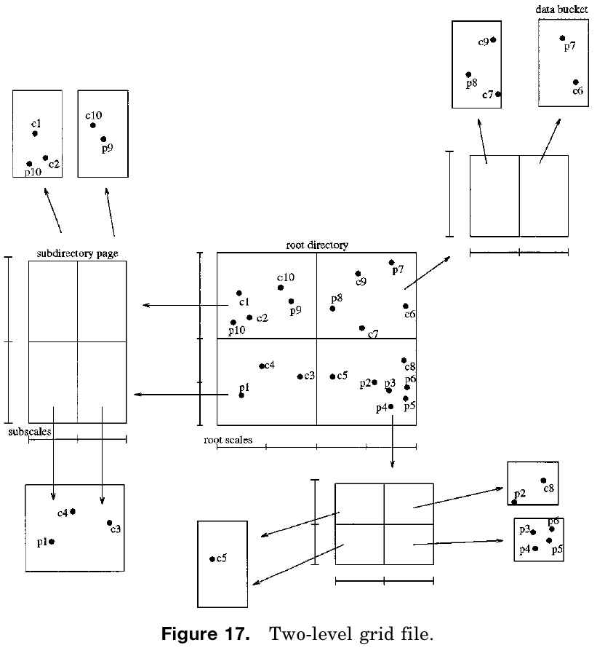
3. PAMs – Multidimensional Hashing
TWO-LEVEL GRID FILE
The Two-Level Grid File

Slide 38
3. PAMs – Multidimensional Hashing
TWIN GRID FILE
The Twin Grid File
Idea: increase space utilization by using second grid file and reduce total number of buckets (or cells) in two files
Two grid files: span whole universe and not hierarchical
Data is distributed between two files dynamically
Insert data:
If bucket overflows, first try to redistribute the data between files
Otherwise split the bucket
Search: requires checking both files
Pros:
Space utilization
Cons:
Inferior to original grid for smaller query ranges
Notes:
Insert data: Could lead to bucket overflow or underflow in one
Make the shift permanent if the number of buckets is minimized

Slide 39
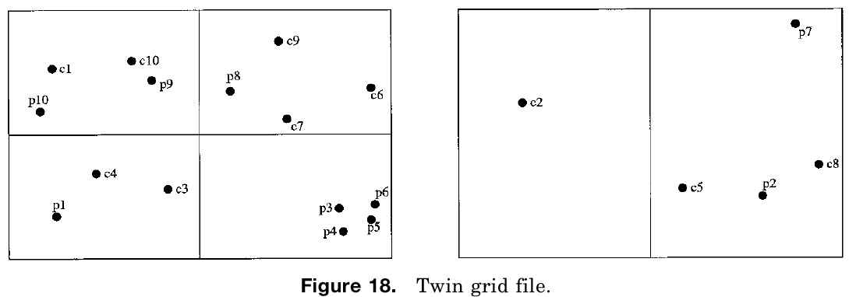
3. PAMs – Multidimensional Hashing
TWIN GRID FILE
The Twin Grid File
Notes:
Each bucket: max 4 points

Slide 40
3. PAMs – Hierarchical Access Methods
OVERVIEW
Hierarchical Access Methods
Based on binary of multi way tree structure
Like hashing: stores data in bucket
Each bucket is leaf of a node, and a disk page
Interior nodes of the tree guide search
Search: top-down tree traversal
Hybrid structures:
BANG File
Buddy Tree
Difference between different methods: characteristics of the regions

Slide 41
3. PAMs – Hierarchical Access Methods
THE K-D-B-TREE
The k-d-B-tree: combination of adaptive k-d-tree and B-tree
Partition the universe like adaptive k-d
Balanced like B-tree
Associates subspaces to tree nodes
Interior node: interval shaped region
Nodes in same level are mutually disjoint
Search straightforward
Insert: find the right bucket; if required, split and move half the data to it
Deletion: search, remove, if necessary merge node with siblings
Cons: no minimum space utilization can be guaranteed

Slide 42
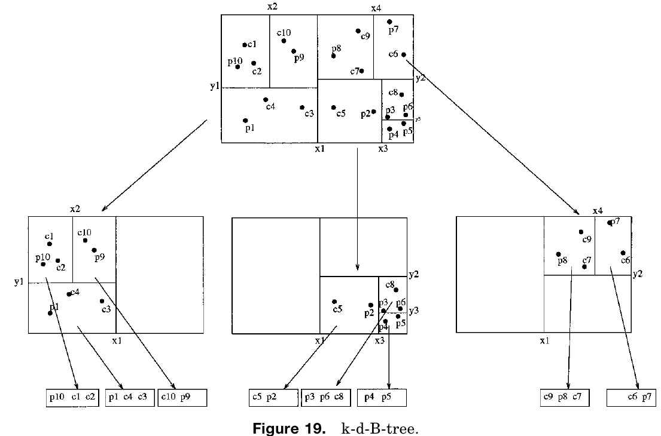
3. PAMs – Hierarchical Access Methods
THE K-D-B-TREE
The k-d-B-tree:

Slide 43
3. PAMs – Hierarchical Access Methods
THE LSD-TREE
The LSD-Tree: (Local Split Decision Tree)
Directory is organized same as adaptive k-d-tree
External balancing property: heights of external sub trees differ at most by one
Two split strategies to accommodate skewed data:
Data-dependent : based on data, tries to achieve most balanced structure (equal number of data in both sides of split)
Distribution-dependent: split at fixed dimension and position (know distribution is assumed)

Slide 44
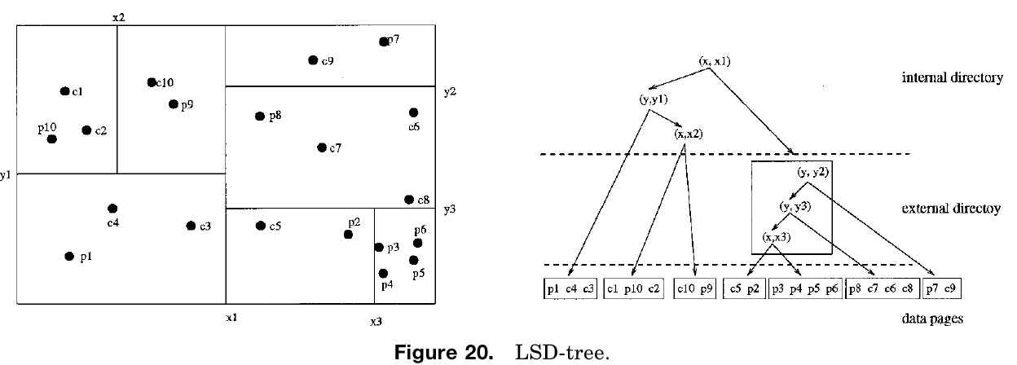
3. PAMs – Hierarchical Access Methods
THE LSD-TREE
The LSD-Tree: (Local Split Decision Tree)

Slide 45
3. PAMs – Hierarchical Access Methods
THE BUDDY TREE
The Buddy Tree: dynamic hashing scheme with tree structure (hybrid)
Split the universe equally with iso-oriented hyperplanes
Interior node: a partition and an interval (MBB of points or intervals below node)
Intervals in same level nodes are mutually disjoint
Leaf node: data point
Properties:
Each directory node has at least two entries: may not be balanced
Except for root, only one pointer refers to each directory page: linear growth

Slide 46
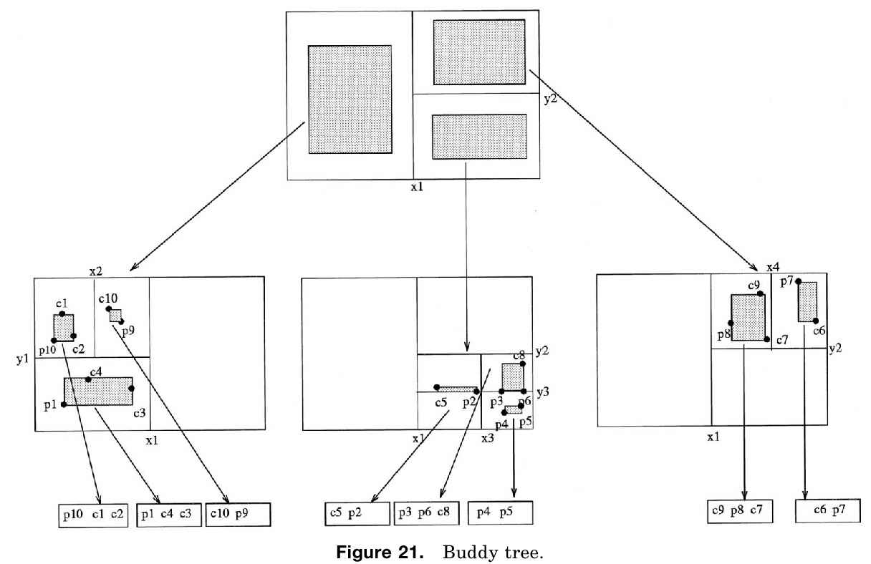
3. PAMs – Hierarchical Access Methods
THE BUDDY TREE
The Buddy Tree:

Slide 47
3. PAMs – Hierarchical Access Methods
THE BANG FILE
The BANG File: (Balanced And Nested Grid File) (hybrid)
Like Grid File: split the universe to intervals (boxes),
But bucket regions may intersect and can form nonrectangular bucket regions by taking geometric difference of two intervals (nesting)
Insertion: redistributes data between bucket to increased storage utilization
Balanced search tree to manage directory

Slide 48
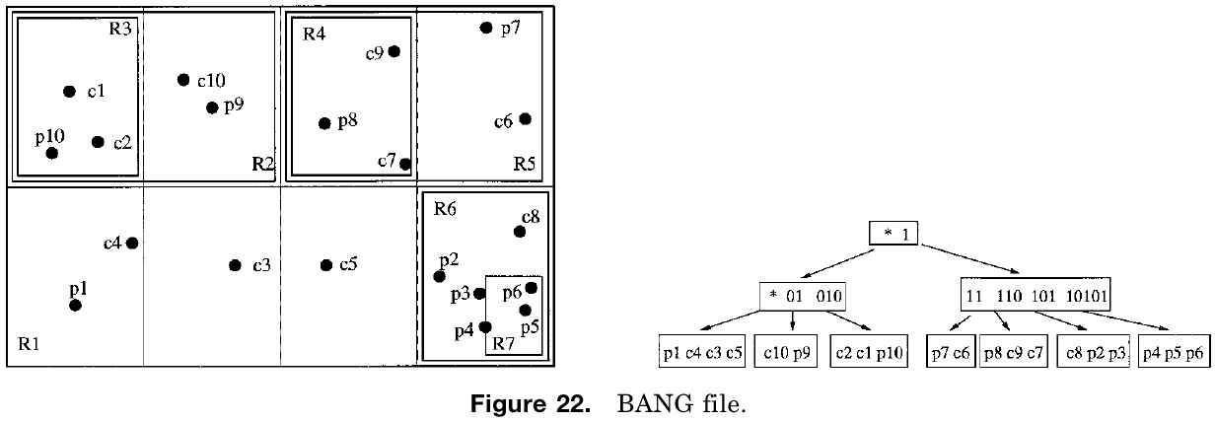
3. PAMs – Hierarchical Access Methods
THE BANG FILE
The BANG File: (Balanced And Nested Grid File) (hybrid)
Notes:
first 3 rectangles: R1: R2, R5, R6
then R3 and R4 in R2 and R5
representation as bit interleaving
* = universe
a point search may require traversal of entire directory in depth-first manner

Slide 49
3. PAMs – Space-Filling Curves for Point Data
Reason that multidimensional is harder than one-dimensional:
No total ordering that preserves spatial proximity
Methods: total orders that preserves proximity at least to some extend
Idea: objects that are close in original space, should also be close in total order (one-dimensional image space)
Maybe good for point queries, not good for region queries
All methods:
Divide space to grids
Assign unique numbers for each grid
Pros: insensitive to dimension
Notes:
Cons: incompatible index partitions can not be joined without re-computing the codes of at least one of the indices

Slide 50
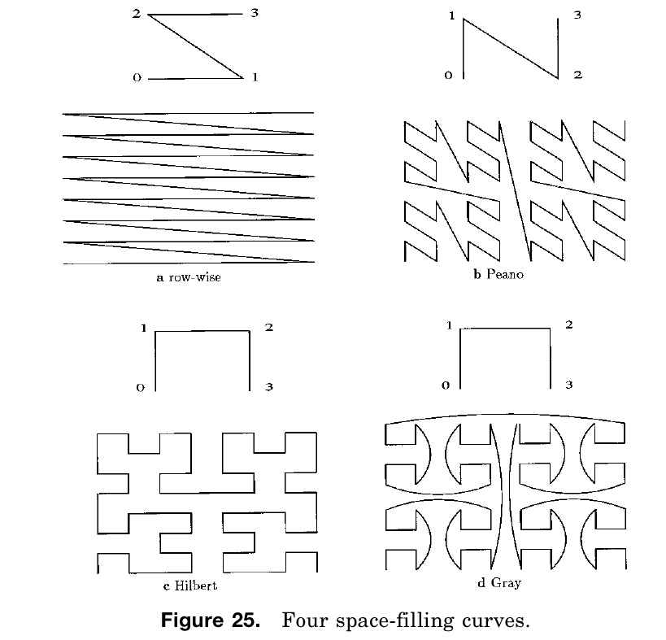
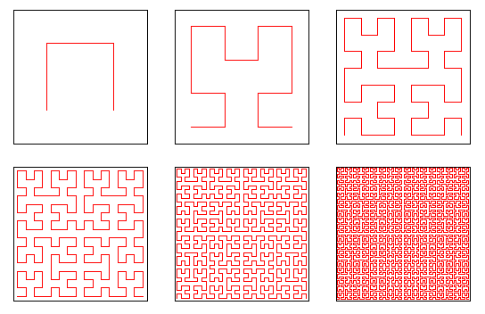
3. PAMs – Space-Filling Curves for Point Data

Slide 51
4. SPATIAL ACCESS METHODS
Transformation
Mapping to Higher Dimensional Space
Space-Filling Curves for Extended Objects
Overlapping Regions
R-Tree
R*-Tree
JP-Tree
SP-Tree
Clipping
Extended k-d-Tree
R+-Tree
Multiple Layers
Multiple layer Grid File
Notes:
Previous methods are for points, not for objects with extension.
How to do objects with extension? modifying point access methods

Slide 52
RUNNING EXAMPLE
Notes:
10 points pi
10 polygon ri: centroid ci & minimum bounding box MBB mi

Slide 53
4. SAMs – Transformation
MAPPING TO HIGHER-DIMENSIONAL SPACE
Mapping to higher dimensional space:
Simple geometric shapes can be represented as points in higher dimensional space
e.g., four numbers ( = to a point in four dimensional space) for a rectangle
Use one of the PAMs for this new point
Options:
Endpoint transformation: x and y coordinates of two diagonal corners
Midpoint transformation: x and y coordinates of center, and height and width
More complex objects: approximate with rectangle or sphere
Notes:
Transformation:
transform object to different representation
then use PAMs or one-dimensional access methods
possible options:
transform each object to higher dimensional point
transform object to one-dimensional intervals using space-filling curves

Slide 54
4. SAMs – Transformation
SPACE-FILLING CURVES FOR EXTENDED OBJECTS
Space-Filling Curves for Extended Objects
Represent extended objects with grid cells
Represents extended object with union of several simpler objects
List of one-dimensional intervals that define position of the grids.
Variations: z-ordering, Hilbert R-tree, UB-tree
Z-ordering: based on Peano curve
Recursively splits universe to equal subspaces with iso-oriented hyperplanes
Z-values: assigned to z-regions and stored in standard one-dimensional index
An approximation of the original object: more z-regions = more accuracy = increase the size and complexity of approximation

Slide 55
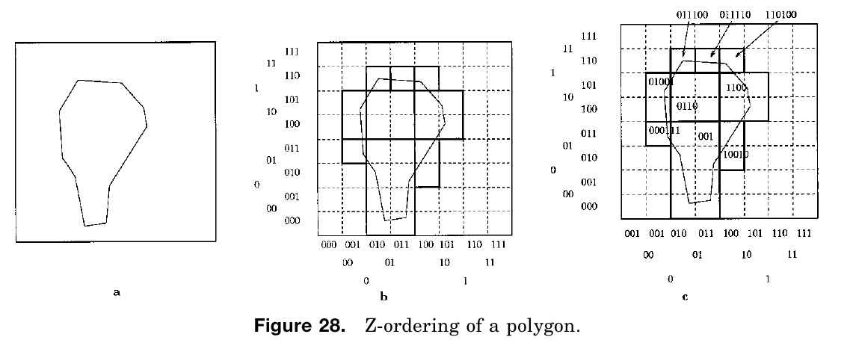
4. SAMs – Transformation
SPACE-FILLING CURVES FOR EXTENDED OBJECTS
Space-Filling Curves for Extended Objects
Z – ordering:
Notes:
9 regions, different shapes and sizes
if peano code z1 if a prefix of z2, then region corresponding to z1 is enclosed in z2

Slide 56
4. SAMs – Overlapping Regions OVERVIEW
Overlapping regions
Idea: different data buckets correspond to mutually overlapping subspaces
Can put any object to one bucket
Extends regions to accommodate new data
Increase search paths (due to overlap), even for point
Problem:
Performance, specially when objects are large in compare to universe
Very large objects lead to ineffective index, the whole index should be searched
Notes:
minor problem: ambiguity during insertion, any subspace could be picked to enlarge
solution:
pick subspace that causes minimal additional overlap or the one that requires least enlargement or takes less time

Slide 57
4. SAMs – Overlapping Regions
THE R-TREE
The R-Tree:
Hierarchy of nested intervals
Nodes correspond to intervals
Intervals of descendant of a node are contained in interval of that node
Same level nodes may have overlap
Leaf node: MBB and reference of the actual data
Other properties:
Each node has between m (lower threshold) and M (upper threshold) entries
Height-balanced: all leaves at same level
Search: similar to B-tree, but several intervals may satisfy the search
Insertion: only one path is traversed, at each node pick the child which requires least enlargement to cover the object
Deletion: may require adjustment in size of the covering interval
Notes:
m: ensures efficient storage
M: maximum number of entries per page

Slide 58
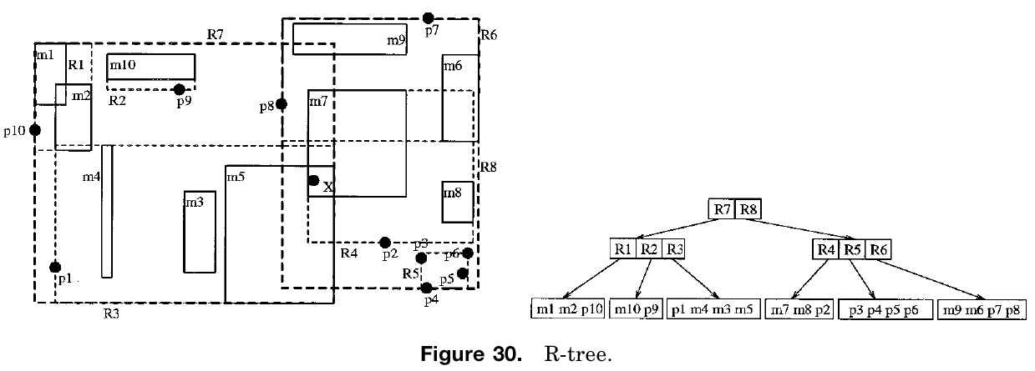
4. SAMs – Overlapping Regions
THE R-TREE
The R-Tree:
Notes:
A point query with search point X results in two paths:
R8 > R4 > m7
R7 > R3 > m5

Slide 59
4. SAMs – Overlapping Regions
THE R*-TREE
The R*-tree:
Forced reinsert policy:
If a node overflows, don’t split right away
Remove some (30% of M) nodes from the node, and reinsert them
Deletion and search are same as R-tree
Splitting policy:
Minimize overlap between same level nodes (less probability for multiple search paths)
Minimized region perimeters (regions should become squares)
Maximize storage utilization
Pros: 50% performance improvements
Cons: CPU overhead for reinsert
Notes:
m: ensures efficient storage
M: maximum number of entries per page

Slide 60
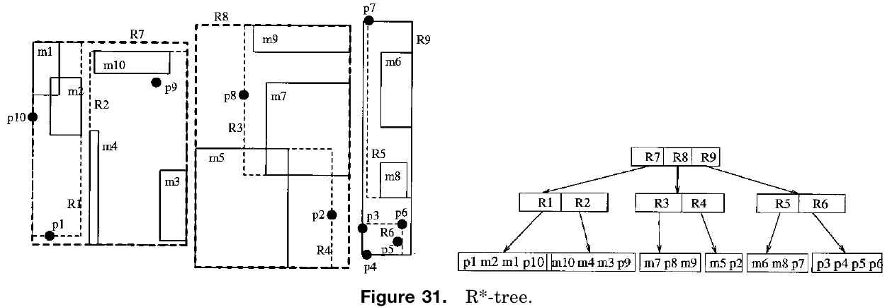
4. SAMs – Overlapping Regions
THE R*-TREE
The R*-tree:

Slide 61
4. SAMs – Overlapping Regions
THE P-TREE
The JP-tree: (Jagadish P-Tree)
Idea: approximations of objects are not MBBs
Introduces m orientation (m > d)
e.g., for d=2, m=4: two parallel to coordinate axes, two parallel to diagonals.
Polytopes are parallel to these orientations
Quality of approximation is related to m.
Interior nodes are nested polytopes (not intervals)
Polytopes in same level overlap
Pros: better approximation
Cons: larger size
Notes:
experimental results: m=10 good for d=2 (5 times more space)

Slide 62
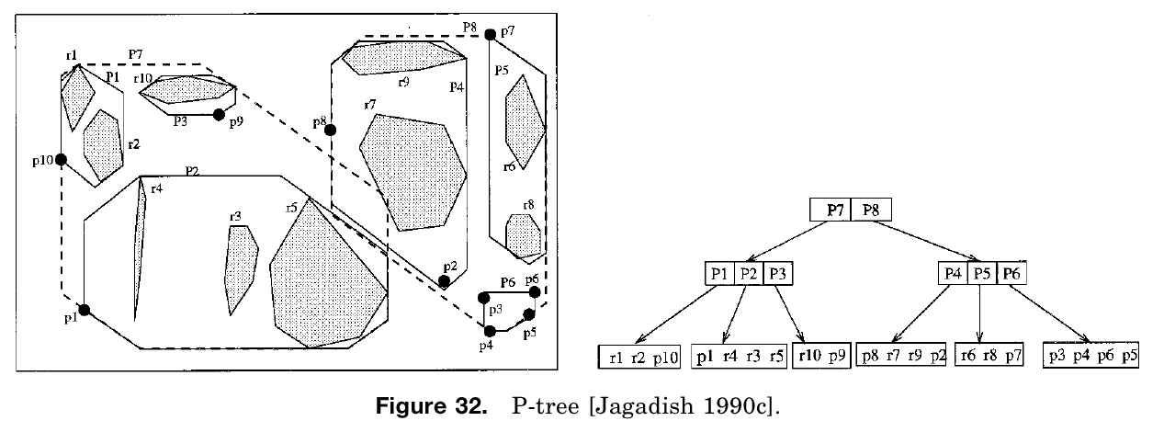
4. SAMs – Overlapping Regions
THE P-TREE
The JP-tree: (Jagadish P-Tree)

Slide 63
4. SAMs – Overlapping Regions
THE P-TREE
The SP-Tree: (Schiwietz P-Tree)
Similar to R-tree, but interior nodes are nested polytopes instead of rectangles
Idea: number of vertices of polytopes are not bounded
If insertion or splitting leads to more vertices for bounding rectangles, surplus vertices are moved one by one.
Pros: more vertices, better approximation
Cons: should be bound to guarantee minimum fanout of interior nodes
Notes:
Combine advantages of R*-tree and cell tree
pentagon and hexagon offer best tradeoff

Slide 64
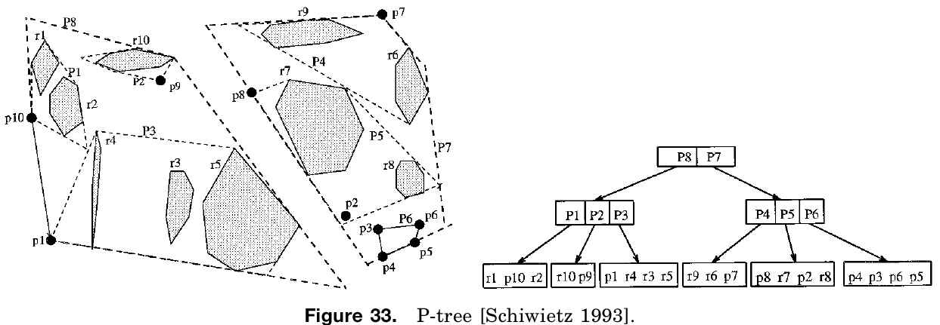
4. SAMs – Overlapping Regions
THE P-TREE
The SP-Tree: (Schiwietz P-Tree)
Notes:
experimental results: m=10 good for d=2 (5 times more space)

Slide 65
4. SAMs – Clipping
OVERVIEW
Clipping
No overlap between bucket regions (mutually disjoint)
Result: point queries follow single path
Cons:
Insertion: any data that spans more than one bucket has to be subdivided along the partitioning hyperplanes. (several bucket entries for same object)
Deletion: has to delete from several buckets
If a method doesn’t partition complete data space, a new object may lead to enlargement of several buckets
Splitting: there might be cases that a bucket has to be split, but there is no hyperplane that splits none of the objects in the bucket (triggers other splits, problem for large files)

Slide 66
4. SAMs – Clipping
THE EXTENDED K-D-TREE
Extended k-d-tree:
Extension of adaptive k-d-tree and based on clipping
Interior node: (d-1) dimensional partitioning hyperplane, represented by dimension and discriminator
Leaf node: rectangular subspace, and address of data page
Data page may be referenced by different leaf nodes
Insert:
Start from root and test intersection with stored hyperplane
Either go to one direction, or clip the object and go in both directions
Overflow case: split page by new hyperplane (dimension perpendicular)
Delete:
Visit all subspaces intersecting with object
Underflow, merge with siblings

Slide 67
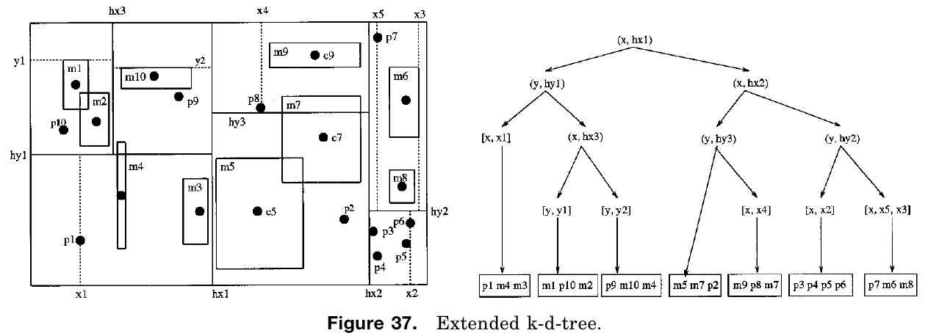
4. SAMs – Clipping
THE EXTENDED K-D-TREE
Extended k-d-tree:
Notes:
m7 clipped and inserted into 2 nodes

Slide 68
4. SAMs – Clipping
THE R+-TREE
R+-tree:
No overlap in same level nodes, if intersect more than one index interval, has to be stored on different pages
Point search: single path (faster than R-tree)
Range searches: usually more than one path
Insert:
Depending on number of intersection, may follow different paths
May place different fragments in different leaf nodes
May need to enlarge interval for a corresponding leaf node, which may overlap with other intervals, then split and reinsert
Delete:
Remove all fragments
If underflow, merge with siblings

Slide 69
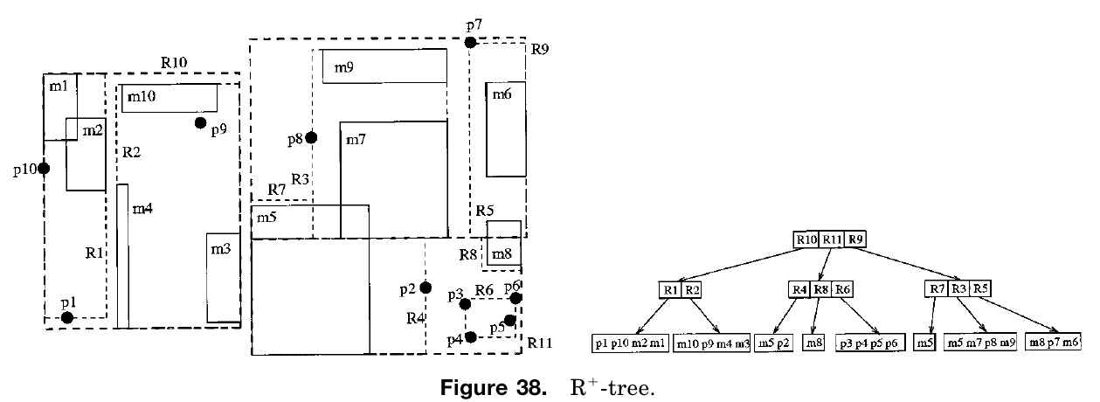
4. SAMs – Clipping
THE R+-TREE
R+-tree:

Slide 70
4. SAMs – Multiple Layers
OVERVIEW
Multiple Layers
A variant of overlapping: data regions in different layers may overlap
Layers are organized in a hierarchy, each layer partitions the complete universe
Data layers within layers are disjoint
Pros:
Possibly higher selectivity during searching due to restricted overlap of different layers
Cons:
Bad for some distributions, fragmentation for large database
Queries require all layers
Notes:
Insert object:
Find lowest layer that its hyperplanes don’t split the object
If there is any, insert in to it
If overflow, split the data region by introducing new hyperplane and distributes the entries accordingly
Object intersect with hyperplane are moved to a higher layer
Result: large object in higher layers, close objects in lower layers

Slide 71
4. SAMs – Multiple Layers
THE MULTILAYER GRID FILE
The Multilayer Grid file
Consists of ordered sequence of grid layers
Each layer covers the whole universe and corresponds to separate grid file
Insert: into first grid file in the sequence that does not imply any clipping of the object.
If a new object can not be stored in any of the current layers without clipping, a new layer has to be allocated.
Search
Exact query: determine from scales which grid files hold search interval
Other queries: traversing sequence of layers, performing search on each
Pros: superior to original grid file
Cons: low space utilization, expensive directory maintenance
Notes:
Insert: Size of the bucket regions typically increase within the sequence (larger object go to later layers)

Slide 72
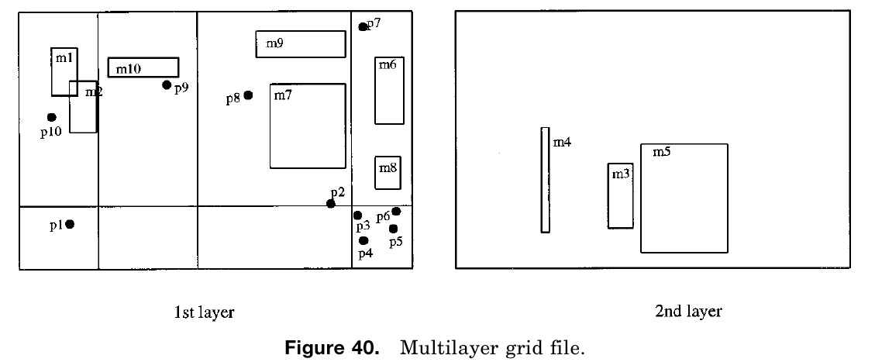
4. SAMs – Multiple Layers
THE MULTILAYER GRID FILE
The Multilayer Grid file

Slide 73
5. CONCLUSIONS
Comparative Studies
Conclusions

Slide 74
5. CONCLUSIONS
COMPARATIVE STUDIES
Results confusing: uniformly distributed, data type, lots of overlaps, …
Search performance: R-Tree, k-d-B-Tree, R+-Tree
R-Tree ~ R+-Tree > k-d-B-Tree
PAMs performance: BANG file, buddy tree, two-level grid file
Buddy tree > BANG file > two-level grid file
For extended objects: R-tree, buddy tree, BANG file (enhanced with transformation technique to handle rectangles)
Buddy tree ~ BANG file > R-tree
R*-tree with several variants of R-tree (performance for point, intersection and enclosure queries, also spatial join, for different data distributions)
R* is the winner for queries, best storage utilization and insertion time.

Slide 75
5. CONCLUSIONS
Different spatial access methods
No one is superior to others in whatever sense
A method is a clear winner by a benchmark, inferior by another benchmark
Reason:
So many different criteria for optimality
So many parameters to define performance
Technology transfer
Pick the method that is easy to understand and implement and robust
Performance not that much important
Try to optimize performance by highly tuned implementation
Notes:
Example:
A good access method for iso-oriented rectangles, may not be good for arbitrarily oriented lines.
A good access method for dense data may not be good for sparse data.
An optimized index method for point queries may be inefficient for region query
A good method for static environment may not be good for an environment which has too many insertion/deletion.
Examples:
Quadtree for SICAD and SmallWorld GIS
R-tree by Informix
Z-ordering by Oracle

Slide 76
References
[1] Volker Gaede, Oliver Gunther. 1998. Multidimensional Access Methods. In Journal of ACM Computing Survey (CSUR) Volume 30 Issue 2, 170-231.

Slide 77
THANK YOU
Q & A

